Slide 1
Classifying Matter Worksheet

Slide 2
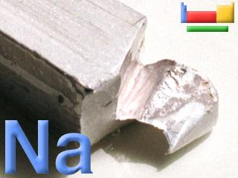
Classify that Matter
Sodium metal (Na)
Element –pure substance that cannot be broken down by chemical means

Slide 3
Classify that Matter
Tea
Homogeneous Solution
composed of two substances. A solute is dissolved in another substance, known as a solvent. The solvent does the dissolving

Slide 4
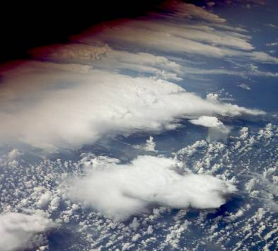
Classify that Matter
Oxygen gas (O₂)
Element – one type and a pure substance that can not be broken down further using chemical means
Molecule consists of two or more atoms of the same element

Slide 5
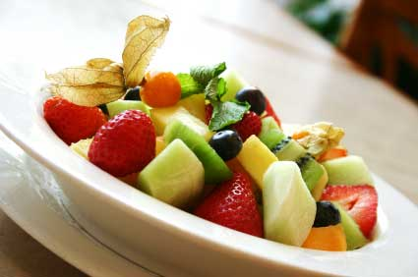
Classify that Matter
Fruit Salad
Heterogeneous
mechanical mixture
combination of two or more substances that, no matter how hard you stir or mix, don't change- they stay as two separate substances, sitting beside each other

Slide 6
Classify that Matter
Apple Juice
Homogeneous
Solution
composed of two substances. A solute is dissolved in another substance, known as a solvent. The solvent does the dissolving.

Slide 7
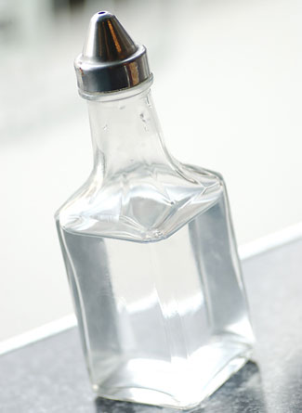
Classify that Matter
Vinegar ( CH₃COOH)
Solution/compound
Solution when it is mixed with water

Slide 8
Classify that Matter
Air
Solution- it is a mixture of gases that are not chemically combined

Slide 9
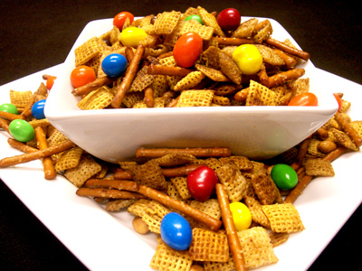
Classify that MAtter
Party Mix
Heterogeneous
Mechanical Mixture
Combination of two or more substances that, no matter how hard you stir or mix, don't change- they stay as two separate substances, sitting beside each other

Slide 10
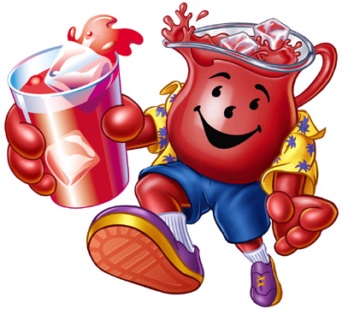
Classify that Matter
Kool Aid
Solution

Slide 11
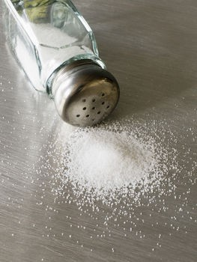
Classify that Matter
Table Salt (NaCl)
Compound
Sodium by itself deadly
Chlorine by itself deadly
Together table salt

Slide 12
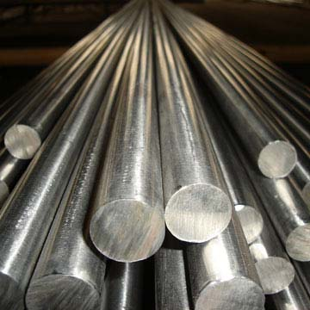
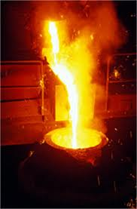
Classify that Matter
Steel
Solution

Slide 13
Classify that Matter
Hot chocolate with marshmellows
Mechanical Mixture

Slide 14
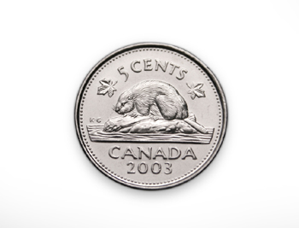
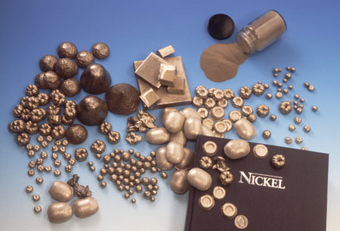
Classify that Matter
Nickel (Ni)
Element

Slide 15
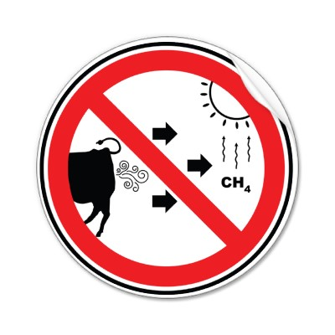
Classify that Matter
Methane gas (CH₄)
Compound
Methane gas comes from all sorts of sources including wetlands, rice paddies, cow tummies, coal mines, garbage dumps and even termites

Slide 16
Classify the Matter
Coffee
Solution

Slide 17
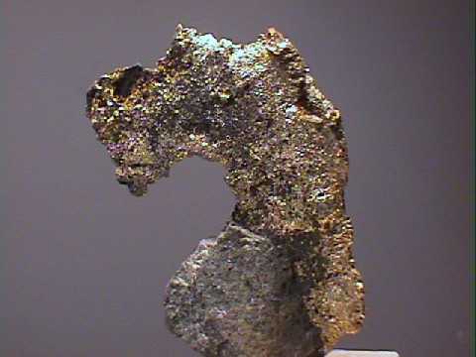
Classify that Matter
Silver (Ag)
Element

Slide 18
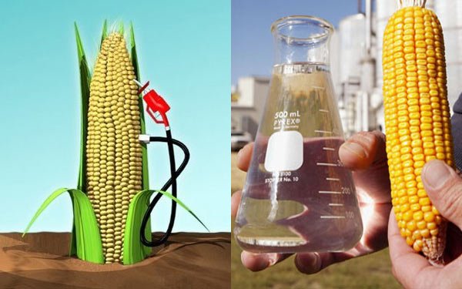
Classify that Matter
Ethanol (C₂H₆O)
Compound

Slide 19
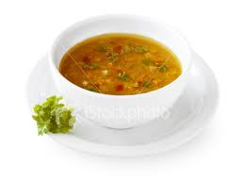
Classify that Matter
Vegetable soup
Mechanical Mixture

Slide 20
Classify that Matter
Cheerios with Milk
Mechanical Mixture

Slide 21
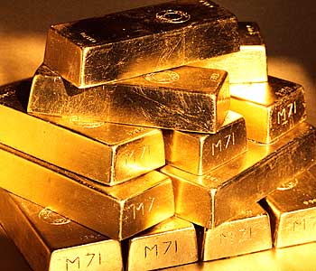
Classify that Matter
Gold (Au)
Element

