Slide 1
WHMIS
What students need to know

Slide 2
WHMIS Stands for…
Workplace
Hazardous
Materials
Information
System

Slide 3
What does it do?
4 Main Parts of WHMIS
Classification and symbols for hazardous materials
Labels
Material Safety Data Sheets (MSDS)
Worker Education

Slide 4
Canadian Standard
All schools and workplaces in Canada use this hazard labeling system
All students and workers in Canada must be WHMIS trained

Slide 5
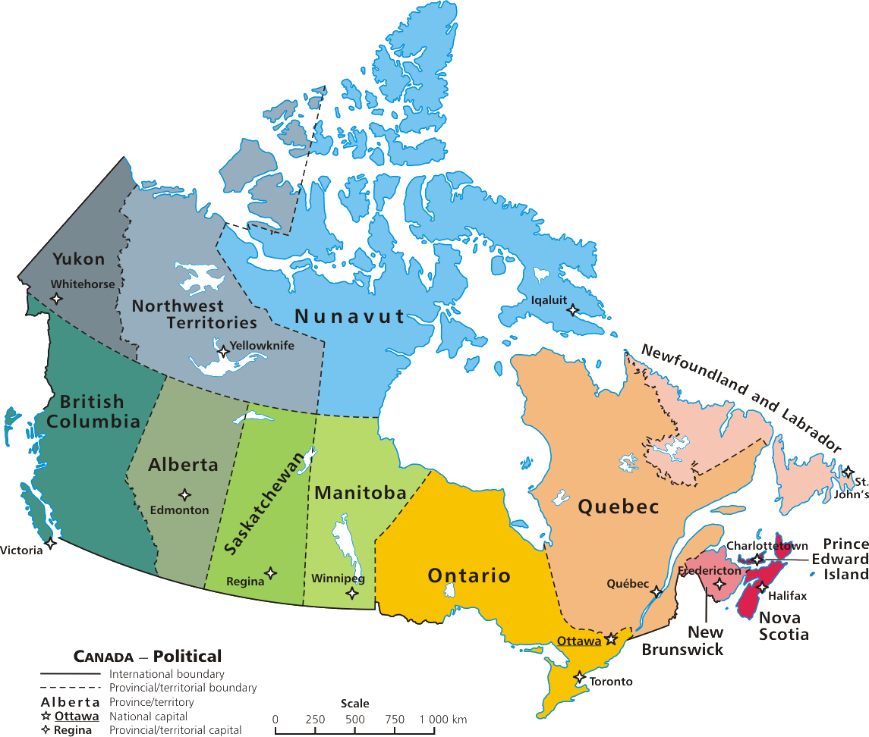

Slide 6
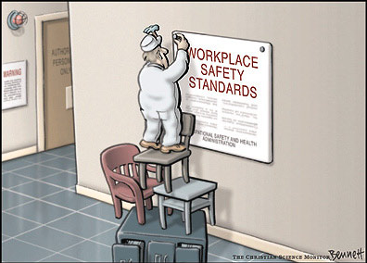
Why is it so Important?
Notes:
Discuss with class

Slide 7
Safety First
Everyone has a RIGHT TO KNOW about health and safety hazards
WHMIS labeling helps stop injuries, illness, deaths, medical costs, fires, and explosions caused by UNSAFE use of hazardous chemicals

Slide 8
In other words…
TO PROTECT YOU!!!!

Slide 9
The 6 Classes
All WHMIS controlled products fall into one or more of 6 classes of hazardous materials
Class A: Compressed Gas
Class B: Flammable and Combustible Material
Class C: Oxidizing Material
Class D: Poisonous and Infections Material
D1 – Materials causing immediate and serioius toxic effects
D2 – Materials causing other toxic effect
D3 – Biohazardous Infectious Materials
Class E: Corrosive Material
Class F: Dangerously Reactive Material

Slide 10
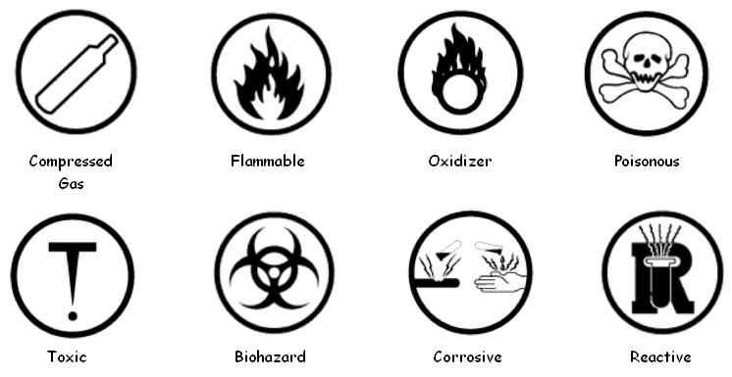
Meet the Symbols

Slide 11
Class A: Compressed Gas
RISKS:
compress gas canisters may explode due to high pressure
EXAMPLES:
oxygen, acetylene, propane, some aerosols

Slide 12
Class B: Flammable
RISKS:
may burn and cause fire
EXAMPLES:
gasoline, chlorine

Slide 13
Class C: Oxidizing Material
RISKS:
may help other materials burn
EXAMPLES:
potassium chloride, nitric acid, ozone

Slide 14
Class D-1: Toxic (immediate)
RISKS:
chemical causing immediate serious illness
EXAMPLES:
cyanide, carbon monoxide

Slide 15
Class D-2: Toxic (long term)
RISKS:
chemical causing other toxic effects (eg. eye/skin irritation, cancer)
EXAMPLES:
mercury, lead, arsenic

Slide 16
Class D-3: Biohazardous
RISKS:
infectious materials causing illness or disease
EXAMPLES:
bacteria (E.coli), virus (HIV)

Slide 17
Class E: Corrosive
RISKS:
Causes burns to skin, eyes, lungs, clothes and metals
EXAMPLES:
hydrochloric acid, sodium hydroxide

Slide 18
Class F: Dangerously Reactive
RISKS:
Causes burns or explode if heated, shaken or mixed
EXAMPLES:
nitroglycerine, aluminum chloride

Slide 19
WHMIS Labels
All WHMIS controlled chemicals must be labeled
To identify a WHMIS label, look for the cross hatched border on the chemical container

Slide 20
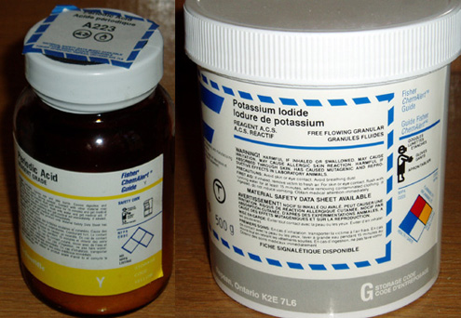
WHMIS Labels
Workplace Label
Supplier Label

Slide 21
WHMIS Labels
Supplier labels are provided by the manufacturer of the chemical and must include:
Name of product
Supplier identifier
Statement referring to MSDS
Hazard symbols
Risk phrases
Precautionary measures
First aid treatment

Slide 22
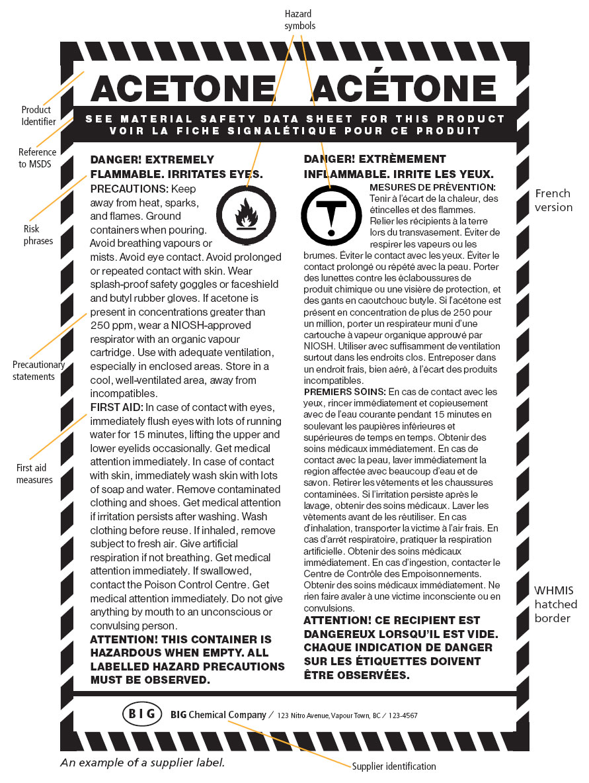
How do you know that this is a WHMIS label by looking at it?
Answer:
It has a hatched border

Slide 23
Name the hazard categories that acetone belongs to:
Answer:
Class B: Flammable
Class D3: Toxic (long term)

Slide 24
What safety equipment should you wear when handling acetone?
Answer:
Goggles and Gloves

Slide 25
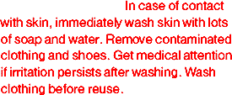
What should you do if you get acetone on your skin?
Answer:
Wash with soap and water

Slide 26
Who is the supplier of this acetone product?
Answer:
BIG Chemical Company

Slide 27
What’s that?

Slide 28
MSDS Stands for…
Material
Safety
Data
Sheet

Slide 29
MSDS
Contains detailed information about a WHMIS controlled product including:
Product identification and uses of the product
Hazardous ingredients
Physical data
Fire and explosion data
Reactivity data
Toxicological properties
Preventive measures
First Aid Measures
Source of MSDS and data

Slide 30
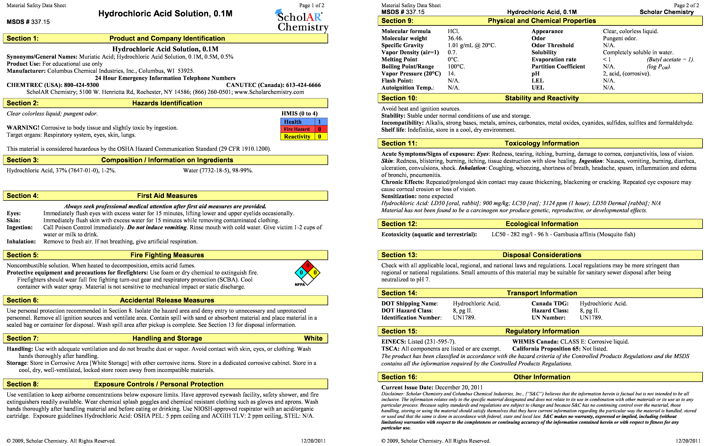
MSDS example

Slide 31
MSDS practice
What is the full name of the product?
Hydrochloric Acid Solution, 0.1M
Section 1
Name the manufacturer, their location and emergency contact information.
Columbus Chemical Industries
Columbus, WI.
CANUTEC (Canada): 613-424-6666
Section 1

Slide 32
MSDS practice
What safety equipment should you wear when handling this product
Goggles, gloves and apron
Section 8
What should you do if you get this product on your skin?
Flush with water for 15 minutes
Section 4

Slide 33
MSDS practice
What should you do if you swallow this product?
Call Poison Control immediately. Do not induce vomiting. Rinse mouth with cold water. Drink 1-2 cups of water.
Section 4
Does this product have an odor?
Yes
Section 2

Slide 34
MSDS practice
What is the WHMIS classification of this product?
Class E: Corrosive liquid
Section 15
What percentage of the solution is water?
98-99%
Section 3

Slide 35
Does EVERYTHING get a WHMIS label?
What do you think? (brainstorm in small groups)
Answer:
NO!!!

Slide 36
Does EVERYTHING get a WHMIS label?
Materials must be HAZARDOUS and be used in the WORKPLACE to be WHMIS controlled!

Slide 37
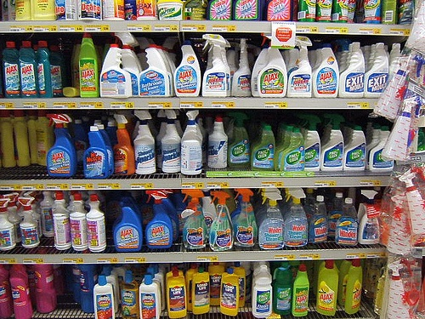
Hazardous Household Product Symbols

Slide 38
Hazardous Household Product Symbols (HHPS)
You will find other symbols on products purchased commercially for home use
Eg. hairspray, garden herbicides, cleaners
For your safety, you should be able to recognize these symbols and understand what hazards they represent

Slide 39
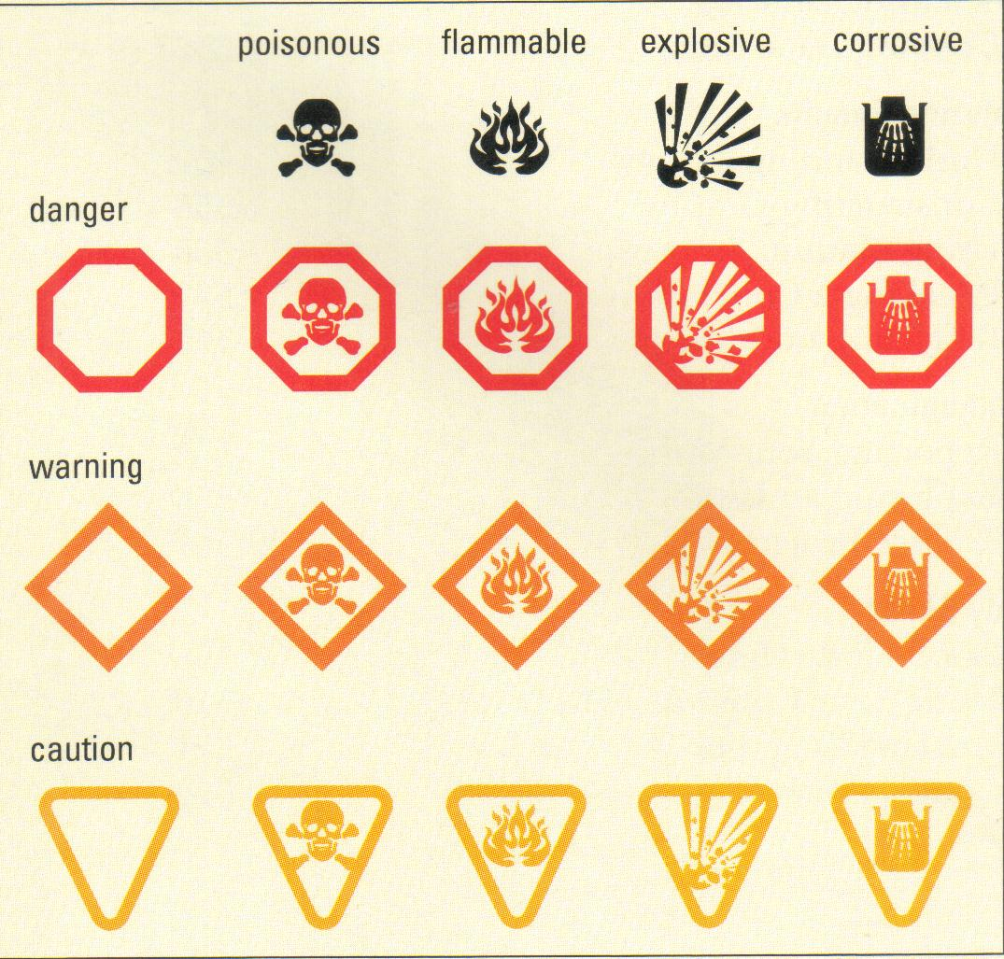
Hazardous Household Product Symbols (HHPS)

Slide 40
Poisonous
May be lethal or cause serious irreversible effects
Flammable
May ignite if exposed to a spark or flame or spontaneously
Explosive
Under pressure and may explode if heated
Corrosive
Will cause chemical burns

Slide 41
Now that you know…

